Slide 1
Watson Studio Data Management and Data Visualization October 2019
Emmanuel Génard – genard@fr.ibm.com
Cloud Developer Advocate Europe &
Data Scientist
Notes:
This is an initial release of a briefing deck. It is meant to be used for 45 min presentation with customization that includes case studies, use cases and demonstration

Slide 2
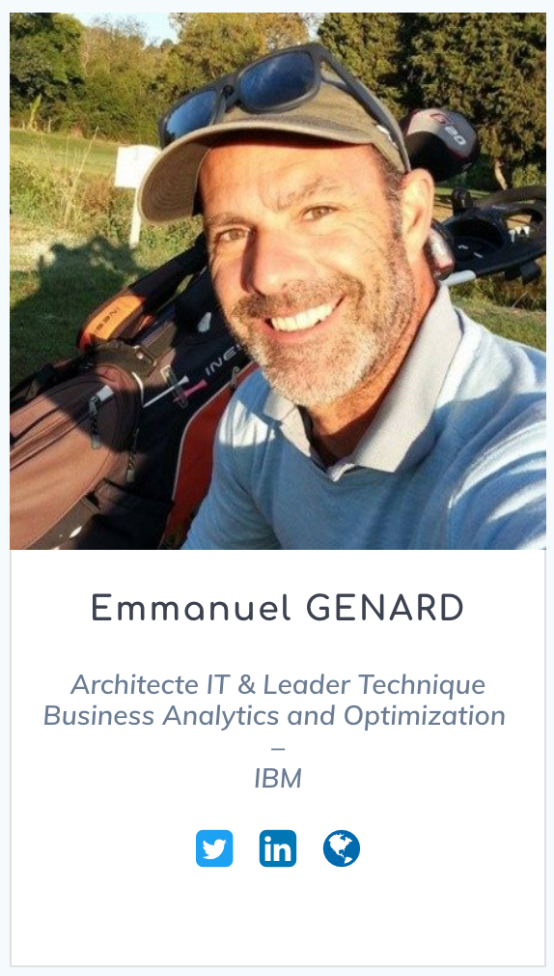


Introduction
I am Emmanuel Génard
You can find me at genard@fr.ibm.com
@manuGenard
http://fr.linkedin.com/in/egenard
Notes:
Qui suis-je?
Objectif des 45 prochaines minutes est:
Montrer que certaines formes d’Intelligence Artificielle peuvent être créer et surtout intégrer dans vos applications pour favoriser la transformation digitale.
→ Machine Learning, Deep Learning, Réseau Neuronaux, Apprentissage supervisé, Apprentissage non-supervisé,
LE deuxième objectif c’est de vous montrer qu’il existe des technologies et des outils qui permettent de démarrer maintenant peut importe (ou presque) votre profil. J’entends par là qu’il ne faut pas obligatoirement avoir un PhD en Mathématiques appliquées, en statistiques ou autre pour y parvenir.

Slide 3



AI is shaping the future of work
Predict and shape future outcomes
Revenue Increase
Empower people to do higher value work
How AI pioneers see value
72%
Automate decisions, processes, experiences
28%
Reimagine new business models
Cost Savings
Notes:
En aidant nos clients dans leur transformation digitale, je suis amené à travailler avec des “pioniers” de l’intelligence artificielle. Pas des pioniers au sens strict du terme puisque les bases des technologies qui supportent l’intelligence artificielle remontent aux années 1950, mais plus des pioniers dans les sens où ces personnes ont réussi le challenge de deployer et d’integrer de l’intelligence artificielle dans les applications et dans leur processus métier.
Les raisons fondamentales pour lesquelles ces clients ont déployé une forme d’intelligence artificielle sont:
Pour faire de la prédiction et anticiper le future (exemple: la prediction météo où on retrouve des modèles de plus en plus précis – le cas present – prediction de scepticémie des patients pour un traitement
Pour valoriser les employés
Pour automatiser des prises de decisions, adapter leur process, capitaliser sur de l’expérience
Pour se réinventer – en somme pour se transformer - , et imaginer des nouveaux business modèles
Un fait marquant qui est ressorti d’une étude faite conjointement avec le MITSloan Institute, est que ces clients qui l’ont en majorité fait non par pour faire des économie mais vraiment dans une optique d’innovation et de generation d’opportunité et de revenue.
Some of our clients paving the way are:
Geisinger (Predict and shape future outcomes) – One sepsis patient dies every two minutes in the US, but over 80 percent of deaths are preventable with prompt diagnosis and care. Geisinger partnered with IBM and used the data science tools available in IBM Watson Studio to develop machine learning models capable of analyzing thousands of patient records and medical journals. Working with IBM, Geisinger has successfully built a predictive model for sepsis mortality based on real-life EHR data, that has helped researchers identify clinical biomarkers that are associated with the higher rates of mortality from sepsis.
Woodside Energy (Empower people to do higher value work) - Woodside, Australia’s largest independent energy company has been a global leader in oil and gas for over half a century. Their secret? Hire and develop heroes. This formula has helped Woodside build some of the largest structures on the planet, in some of the most remote parts of the ocean, and safely transport the energy they produce to people around the globe. To ensure the next generation could successfully carry the torch, Woodside knew they had to harness the instinctual know-how of their best employees. This goal — to create a cognitive business to augment and share their tribal knowledge — is what led Woodside into an industry-first partnership with IBM and Watson.
Experian (Automate decisions, processes, and experiences) -- Experian collects and aggregates information on over one billion people and businesses including 235 million individual US consumers and more than 25 million US businesses. Currently they use a rules-based system to determine if a file should be automatically loaded or checked. However, this system misses may correct files, resulting in additional human labor to check files and load them manually. Experian worked with IBM Watson Studio to reduce the number of files sent to be checked by approving them directly in the load process using machine learning techniques to classify these documents and descriptive analytics to get a better understanding of how the current rules are working, and successfully reduced 96% of false positives and 95% of false negatives.
Legalmation (Reimagine new business models) -- With intuitive IBM® Watson® offerings, LegalMation developed a first-of-its-kind AI platform to automate routine litigation tasks. Supported by the IBM Watson ecosystem, the company quickly launched its solution for drafting early phase response documents, helping legal teams save time, drive down costs and shift strategic focus.

Slide 4




However, AI is not magic
Achieved a 40% call deflection rate with
virtual agents
Cognitive car manual explaining increased vehicle complexity
Identifies gaps in terms in complex RFPs
Mercedes-Benz
Visually categorize damage & instantly issues quote
Predict power demand by for renewable energy
Our learnings from experience in helping thousands of enterprises put
AI to work
Predict fraud across their web & mobile banking system
iKure
Optimize cardiac care in high volume remote regions
Surface hidden
insights to optimize fantasy football outcomes
AI-powered advertising engagement
Predict and target first-time buyers in the US
4
Notes:
But those AI pioneers are just some of the few. There are thousands of clients IBM is helping put AI to work, and while these clients are on various stages in their own journey, they all have one thing in common -- they are transforming their business through the use of AI.
AutoGlass & Compagnie d’assurance: estimation des dégats
RBS: agent conversationnel (Chatbot) pour un centre d’appel et traiter les questions des usagers. Ca permet de libérer les télé-opérateurs pour qu’ils traitent les cas plus complexes (et donc valoriser et augmenter la valeur de la travail)

Slide 5
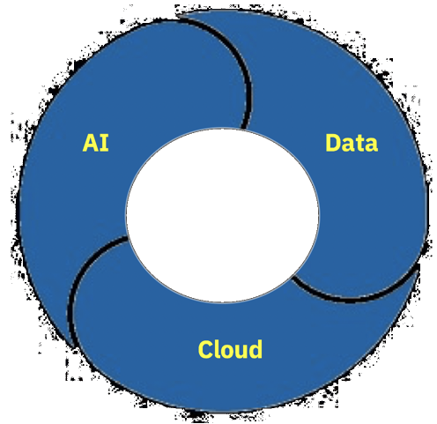

An Information Architecture for AI
Eliminate data silos, connect all data, on any cloud(s)
Automate and govern a unified data & AI lifecycle
82% concerned about cross cloud [data] connectivity
66% of cloud workloads
will be AI-driven
One Platform, Any Cloud
Operationalize AI with trust and transparency
Avoid lock-in, run anywhere with agility
94% use multiple
clouds platforms
62% need an approach and process for AI
Notes:
Une architecture d’information c’est la base – les fondations sur lesquelles les données sont structurées et organisées au sein d’une entreprise. Avec une architecture unifiée, prescriptive les organisations peuvent:
Eliminer le cloisonnements qui peut exister entre les données – en somme – eclater les data silos
Automatiser, manager et gouverner ses données mais aussi le cycle de vie d’une IA (de la creation/apprentissage au déploiement, à la mise en production, au réapprentissage...)
Operationaliser l’IA avec transparence (c’est primordial – avoir confiance dans les prises de decision et choix fait par un algorithme mais aussi pour tracer le processus de decision)
Avoid vendor lock-in to run anywhere with agility
So, where should they start?

Slide 6

Putting AI to Work for Business
One use case at a time…
To Accelerate AI,
You need the right Platform
Integration & Trust
Integrate AI in your business workflow and Applications
Tools
Apply latest AI Technologies and Techniques
Skills
Build an open, collaborative and Data Science team
Data
Unlock Data & Break Down Silos
Use Case
Articulate Use Case - Source of Value
Agile
Create an Agile process to iterate use case development, Winning with AI is based on Rate and Pace of projects
6
Notes:
We’ve done 100s projects with clients and there is a pattern of how to put AI to work for business
Steps to win with AI
Start with Use Case (this is where the value is) – faire une session de Design Thinking
See what data you have available (potentially perform some Data Discovery)
Determine the skills you have on your team – programmatic or Bas
You need a variety of tools to get there
And will need to be able to trust that your ML will do what you want in an application
You need the right platform to accelerate AI from Data discovery, support skills diverse and integrate AI in your business workflow

Slide 7

Turning AI aspirations into outcomes
DATA
TALENT
TRUST
The lifeblood of AI, but complexity slows progress
AI skills are rare
and in high demand
Skepticism of AI systems & processes
60%
Are challenged in managing data quality
62%
Are challenged to acquire talent [and build skills]
62%
Need an approach to
AI production readiness
Stuck in Experimentation
find operationalizing, sustaining
and scaling AI challenging
51%
Based on 2019 Forrester “Challenges That Hold Firms Back From Achieving AI Aspirations”
7
Notes:
However, to ensure a successful AI strategy, organizations need to understand how to adopt and implement the technology and realize there will be failures along the way. In order to turn AI aspirations into outcomes, organizations need to overcome three major AI challenges: data complexity, skills, and trust.
AI Challenge: Data Complexity
Data is the foundation and fuel for businesses to drive smarter decisions particularly as they embark upon digital transformations. The problem is that while 90 percent of business leaders list improving the use of data as a top priority, only 15 percent of them are actually getting what they need from their data. As a result, the majority of businesses have a plan to build a system of insights to become data-driven and have declared the journey to AI as a strategic priority. Data is the lifeblood of AI, and if organizations don’t solve for its complexities, their progress can be slowed by data siloes, incomplete data, and the appropriate approach to governance.
AI Challenge: Skills
Data is the lifeblood of AI, but you also need skills , such as knowing how to code, understanding and building deep learning and machine learning models, to bring AI to fruition. The challenge is that AI skills are rare, and therefore in high demand, so there’s a shortage of skilled workers available to hire. This makes it even more important that the technology being built and used is more easily accessible to everyone within the business, regardless of skill level.
AI Challenge: Trust
For organizations to truly embrace and scale AI across the entire businesses, they need to break open the ‘black box’ of AI and trust the systems. It is critical to ensure AI recommendations or decisions are fully traceable – enabling enterprises to audit the lineage of the models and the associated training data, along with the inputs and outputs for each AI recommendation. As more applications make use of AI, businesses need visibility into the recommendations made by their AI applications. In the case of certain industries like finance and healthcare, in which adherence to GDPR and other comprehensive regulations present significant barriers to widespread AI adoption, applications must explain their outcomes in order to be used in production situations.
For AI to thrive, and for businesses to reap its benefits, it is imperative that organizations are able to address these three challenges to ensure they have trust their AI systems, have the right skills across their organization, and access to their data, no matter where it resides.

Slide 8
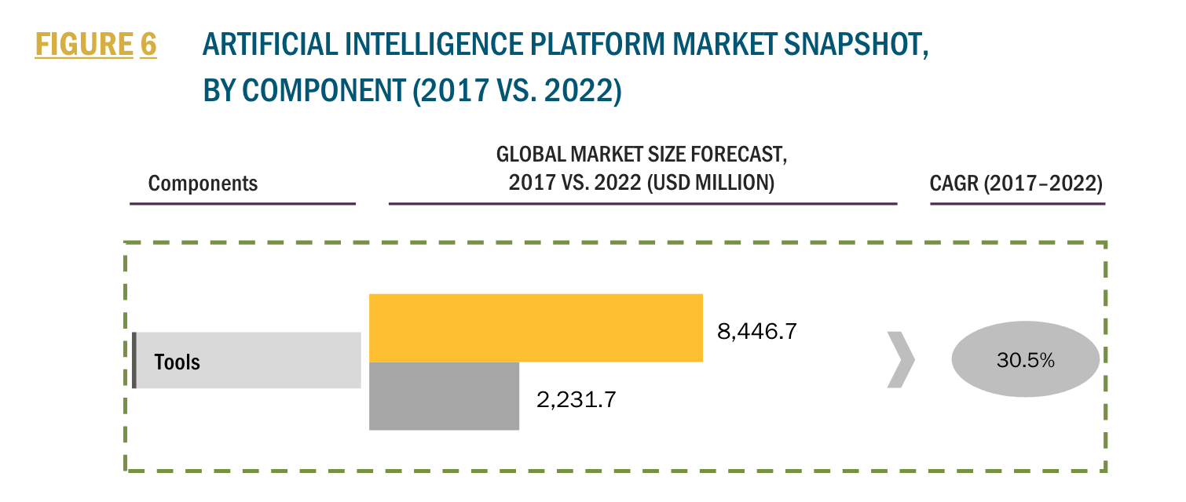
Skills Problem?
Rapidly Growing Market
AI Platform Market expected 30.5% CAGR from 2017 to 2022
Investment in building models and productizing them to generate this revenue will be to the tune of several 100 Billions
The above research estimations were done using bottoms up analysis – and excluded services
https://ibm.northernlight.com/document.php?trans=view&docid=IB20171121610000024&datasource=IBM&context=BNES
Decision Support & Augmentation
Models for enhanced insights and decision support tools
Decision Automation
24B
Models to deploy in production workflows
1.76T
640B
.43T
27X growth!
4X growth
2018
2022
2018
2022
Notes:
CAGR = Compound Growth Rate

Slide 9
There are three major challenges for developing AI applications today:
Challenge
IBM’s Strategy
Enterprise data is fragmented
Moving data is costly, risky, and slow
Duplication can lead to different outcomes
Move data science to the data
Multi-cloud support
Pushing model training to Cloud, Hadoop, Mainframe, GPU-supported infrastructure
Data Scientists are a scarce resource
Diversity in skill levels, and preferences for different open source frameworks
Computationally intense workloads (Big data, Deep Learning) constrain productivity
Citizen data scientists emerging
Enable Expert & Citizen Data Scientists
Reduce barriers to distribution of work
Visual productivity tools
Intelligent management of AI infrastructure
High performance HW/SW acceleration
Automating Data Science
Operationalizing AI is hard
Hard to trust how models perform in production.
Data scientists difficulty with integration into engineering and support efforts
Operationalizing introduces security, scalability, governance constrains
Full AI Lifecycle, including Open Source
Ease & flexibility of deployment
Security, compliance and governance
Advanced model management capabilities
Extend to Deep Learning and AI applications
Notes:
These wants & problems are found across all clients. We have developed these 3 challenges we consider macro challenges that effect the whole industry…
When I talk with Data Science Leaders there are 3 major challenges that impede their progress on their AI journey.
These 3 challenges are influencing IBM’s investment strategy in data science.
Data Fragmentation
Skills shortage
Infusing the AI into Production applications
Skills represent a couple challenges.
There is a diversity of skills needed within the data science team. Data Scientists may choose to develop in R and Python as their default tools of choice. But when they want to solve NLP or Deep Learning they are more likely to need Pytorch or TensorFlow. And for big data they may turn to Spark or Scala. That’s a lot of tools for a single person to master, and the time needed to learn and stay current on all of these is a significant challenge.
The second Skill challenge is the shortage of Data Scientists. In addition to the tools mastery we just discussed, a Data Scientist must be an expert in 3 different domains; mathematics, computer science and business domain expertise. This combination makes a true Data Scientist a scarce resource that needs to be applied to the problems and models only they can solve.
Because of this we are seeing a rise in the number of Citizen Data Scientists. They have the deep domain expertise and are supported by tools that don’t require a PhD in mathematics or computer science.
The 2nd major trend or pain point is caused by the abundance of Data. Data is frequently fragmented across various locations. This is nothing new, but has been made more severe based on clients moving some of the data to the cloud… and in many cases, multiple clouds. And while clouds make it easy to move your data to them, they aren’t as easy to get your data off this environments.
All of this increases the chance that incomplete or stale data is being accessed for Data Science. This in turn compromises the validity of the models produced and the insights gained from them. Garbage in, garbage out.
The 3rd major challenge is taking your AI and Predictions from experimentation to production where it adds the most value
Operationalizing data science has always been hard. The cost and time it takes to deploy a trained model often keeps clients from getting the true benefit of operationalizing (deploying) their trained data science models. And this is where top companies get the real value form their data science investment.
I’ve heard that operationalizing AI is like trying playing Rugby in 6 inches (15 cm) of mud. Operationalizing Data Science (actually deploying models into a production environment where applications can call the models) requires skill sets not often found in Data Scientists. To operationalize Data Science and embed into applications you need software engineers and Dev Ops experts skilled in building secure, scalable, governed enterprise-class applications.
Another challenge with Operationalizing AI is that many organizations struggle with trusting their AI to make critical decisions, so they don’t deploy the models they’ve taken months to build and train.
So what’s IBM’s strategy?
Move DS to the data
To address the data challenge… unlike AWS and Azure we allow Data Science teams to move their data science to the Data. We don’t require them to move their data to our Data Science platform. This is a huge IBM differentiator from these large Cloud providers. We allow clients to avoid the extra cost, time and risk it takes to move the data, ensure governance, avoid incomplete and stale data.
We allow clients to push model training to the cloud, to Hadoop (with our Hadoop Integration Services), to the Mainframe (using WML) and to GPU supported infrastructure using (WML Accelerator for GPU).
Enable Expert & CDS
Our strategy is to provide productivity tools for everyone involved in the Data Science team sport including Open Source. Some clients are spending large amounts of time and money on a Build Your Own (BYO) Data Science Platform approach that does not allow everyone in their organization to “play” in the Data Science game.
Our strategy allows clients to distribute the workload across a variety of roles such as citizen data scientists, LOB professionals and data engineers. Some clients are under the impression they can build their own data science platform. One client spent over 2 years and several million dollars to build a fraction of what we have in Watson Studio and WML. And they’d need a development staff of 200-300 developers to keep up with where we are going. And in the end, most home-grown data science platforms don’t provide anything to the citizen data scientists.
And unlike SAS, we provide team productivity tools while embracing Open Source! SAS is programmatic and embracing OpenSource conflicts with their approach.
So clients can have both - Use their Open Source tools-of-choice AND distribute workloads to Citizen Data Scientists and Data Engineers on the same platform.
Citizen Data Scientists are important to team success and Gartner predicts that Citizen Data Scientists will grow at 5x the rate of expert Data Scientists through 2020 https://www.gartner.com/document/3891569.
Think of a Data Science team like a surgical team. The surgeon may be the person everyone focuses on, but it takes a variety of skills to perform a successful operation – surgical tech, operating room nurses, Anesthesiologists. And while the patient may think that they need a team of all surgeons to perform every role, that isn’t the best mix of skills for a successful surgery, it’s not cost effective and surgeons are not interested in performing those roles. The same goes for a Data Science team. Not everyone needs to be a Data Scientist and they need different tools.
In summary, our strategy to address this industry trend is to embrace Open Source AND provide tools that allow workload distribution to the whole team – all in one platform
Full AI Lifecycle, including OS
IBM enables the full AI Lifecycle – build, train, deploy, manage and infuse AI with confidence and transparency.
We make deployment and ongoing training straight forward for Data Science teams, speeding up the time-to-value and lowering ongoing costs of maintaining models. It is important to note here model accuracy can change over time and we have the ability to track versions to ensure that you are feeding the right models to downstream applications or dashboard.
IBM allows clients to confidently deploy their AI by giving them transparency into how decisions were made and to detect bias in the models. Clients are afraid to turn over decision-making to AI. Why?
There are several popular media services that use AI and ML to detect patterns in your movie selections. And they recommend movies based on what they’ve learned. But what if they start recommending the wrong types or inappropriate of movies? You can’t fire the ML, but you can fire the person that deployed it!
Amazon HR reportedly used an AI-enabled recruiting software between 2014 and 2017 to help review resumes and make recommendations. The software was however found to be more favorable to male applicants because its model was trained on resumes submitted to Amazon over the past decade, when many more male candidates were hired. We help detect such bias.
Microsoft’s chatbot Tay was meant to be an experiment in AI and machine learning, but it only took 24 hours for the bot to turn racist. ‘Tay’ was supposed to speak like millennials, learning from the people it interacted with on Twitter and the messaging apps Kik and GroupMe. But the transgression from “Humans are super cool!” to “Hitler was right” were disastrous.
Back in 2015, software engineer Jacky Alciné pointed out that the image recognition algorithms in Google Photos were classifying his black friends as “gorillas.” Google said it was “appalled” at the mistake, apologized to Alciné, and promised to fix the problem. But, as a new report from Wired shows, nearly three years on and Google hasn’t really fixed anything. The company has simply blocked its image recognition algorithms from identifying gorillas altogether — preferring, presumably, to limit the service rather than risk another miscategorization
So these types of major issues makes adoption a problem. How do clients deal with it?
Deploy and take risk. Could be OK for low-cost, low-risk applications.
Deploy but manually monitor with Data Scientists
Do not deploy or adopt, and therefore miss out on the tremendous value.
IBM’s Watson OpenScale explains why decisions were made and detects bias.
This gives clients the confidence and trust to deploy their AI.
----
Data Science is one of core technology disciplines that organizations are looking at today to succeed in driving value.
There are three major trends in the industry that are influencing IBM investment strategy in data science.
First:
moving data creates cost and risk for companies, so we allow companies to move their models or algorithms in a data science platform to their data instead of the other way around. This reduces cost, time and risk of moving large amounts of data, especially sensitive data.
Second:
Data Science teams are typically made of up a variety of skills. Retaining people to use proprietary tools takes time, and can cause dissatisfaction in data scientists. We allow them to use the tools they love. R, Python, SPSS, CPLEX... to name a few (more details are provided on a later slide). Furthermore, in order to realize the value for your company, the workflows have to be established to move through the entire lifecycle that address line of business, center of excellence or general IT – or a blend of all. This is why offer integrated, multi-modal approach to address varying organizational needs.
Third:
Operationalization is hard. Model of the models tend to get stuck in the experimentation / training phase – many projects simply fail. The cost and time it takes to deploy a trained model often robs clients from getting the true benefit of operationalizing (deploying) their trained data science models. This is where top companies get the real value form their data science investment. We make deployment and ongoing training easy for your teams, speeding up the time-to-value and lowering ongoing costs of maintaining models. It is important to note here model accuracy can change over time and we have the ability to track versions to ensure that you are feeding the right models to downstream applications or dashboard.
These are concerns many of my clients have also shared. Which of these trends are you experiencing in your company?
Remember: The goal of this short deck is to give a high-level overview of Watson Studio and Watson Machine Learning without diving deep into the technology and data science terminology. If you get questions that are more technical or that you don’t know the answer, then offer to answer that question during the live demo with your Tech Seller at the next meeting.

Slide 10
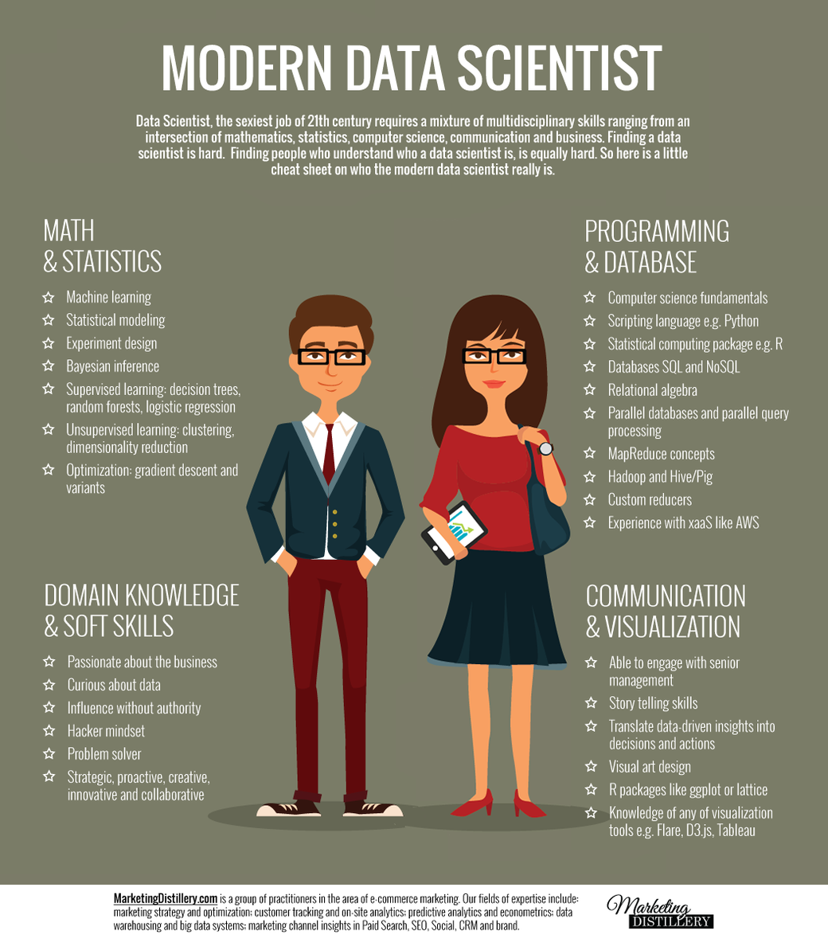
What is a Data Scientist?
A data scientist is a professional responsible for collecting, analyzing and interpreting large amounts of data to identify ways to help a business improve operations and gain a competitive edge over rivals.
Data Scientist is the sexiest job of the 21th century.
Notes:
Qu’est ce qu’un ou une data scientist ??
C’est un professionnel en charge de la collecte, l’analyse et l’interpretation de gros volumes de données pour déceler des opportunités d’améliorer les opérations, de prédire un résultat, de se différencier par rapport à la concurrence.
Compétences diverses: mathématiques et statistiques, en programmation, en traitement de la données, mais aussi en data visualization, une très bonne compréhension métier, des compétences de communication etc…

Slide 11
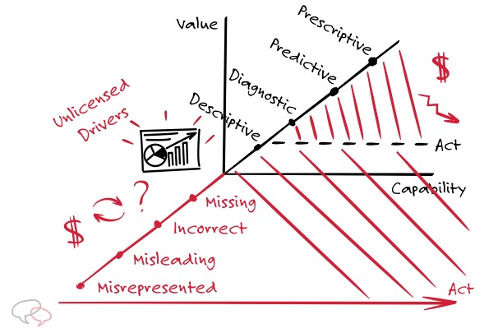
Flavors of Data Science – Turning data into Information, Insights and Actions
Descriptive and Diagnostics:
WHAT happened?
Visualization, Reporting, Dashboards
WHY did it happen ?
Data Exploration, Analysis
Predictive:
What WILL happen next?
Forecasts and previsions
Machine Learning (incl. Deep Learning)
Prescriptive:
What should we do ?
Actionable Insights
Optimization (Operational Research, Constraint Programming)

Slide 12


IBM AI Portfolio
Everything you need for Enterprise AI, on any cloud
Interact with Pre-built AI Services
Watson Application Services
The Ladder to AI
INFUSE
Build
Deploy
Catalog
Manage
ANALYZE
Watson
Studio
Watson Machine Learning
Watson
Knowledge
Catalog
Watson OpenScale
ORGANIZE
COLLECT
AI Open Source Frameworks
Unify on a Multicloud Data Platform
IBM Cloud Private for Data
12
Notes:
So that’s why IBM AI portfolio has everything you need for Enterprise AI, on any cloud.
We have prescribe approach for you to enable the AI Ladders – Collect, Organize, Analyze and Infuse.
IBM combines the best of Open source frameworks with powerful capabilities rooted in our history pioneering AI and data science.
IBM Cloud Private for Data is designed to unify your AI Assets on a Multicloud Data Platform
Interact with Pre-built AI services with Watson Applications
Then look at build, deploy, catalog and manage.
CLICK: Watson Studio and Watson Machine Learning handles the build and deploy stages of AI Lifecycle. What’s more.
Watson Studio and Watson Machine Learning are built ground up to meet today’s AI needs. You want to directly impact your business. You are collaborating with Application development and dev ops team

Slide 13
Watson Studio

Slide 14













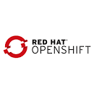


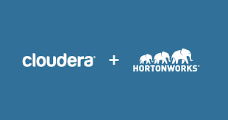
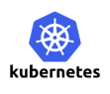
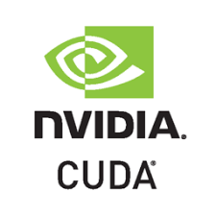
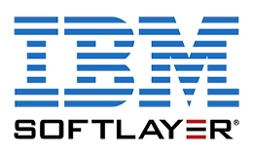



Watson Studio and Watson Machine Learning inject AI firepower into your business
Build and train at scale
Embed ML in your business
Authoring Tools
Operationalize
AutoAI
Decision Optimization
ML/DL Models
Python/R Functions
Data Pipelines
Notebooks
Machine Learning Runtimes
Deep Learning Runtimes
Deployment methods
Batch
Edge
Scalable & modern infrastructure
Hadoop Execution Engine
On x-86, Power + GPUs
Management & Monitoring
Version Control
Lineage
Automation
Watson Studio
Watson Machine Learning
Mix and Match your deployment
Cloud – IBM Cloud, Azure, AWS
On Premise / Private Data center
Desktop
On-prem
Notes:
Watson Studio and Watson Machine Learning inject AI firepower into your business
We have a simple unified and end to end environment to address two stages of cycles
Build and train at scale
Embed ML in your business
We set ourselves apart in many ways – one of the impactful ways we serve our clients is that we have flexible deployment – multi-cloud, on-premise / private data center and desktop
You can mix and match to meet your needs
Both worked to complete the data science lifecycle – that scales, can speed and is simple for you to inject AI firepower into your business
Let me explain Watson Studio and Watson Machine Learning in the next two slides.

Slide 15

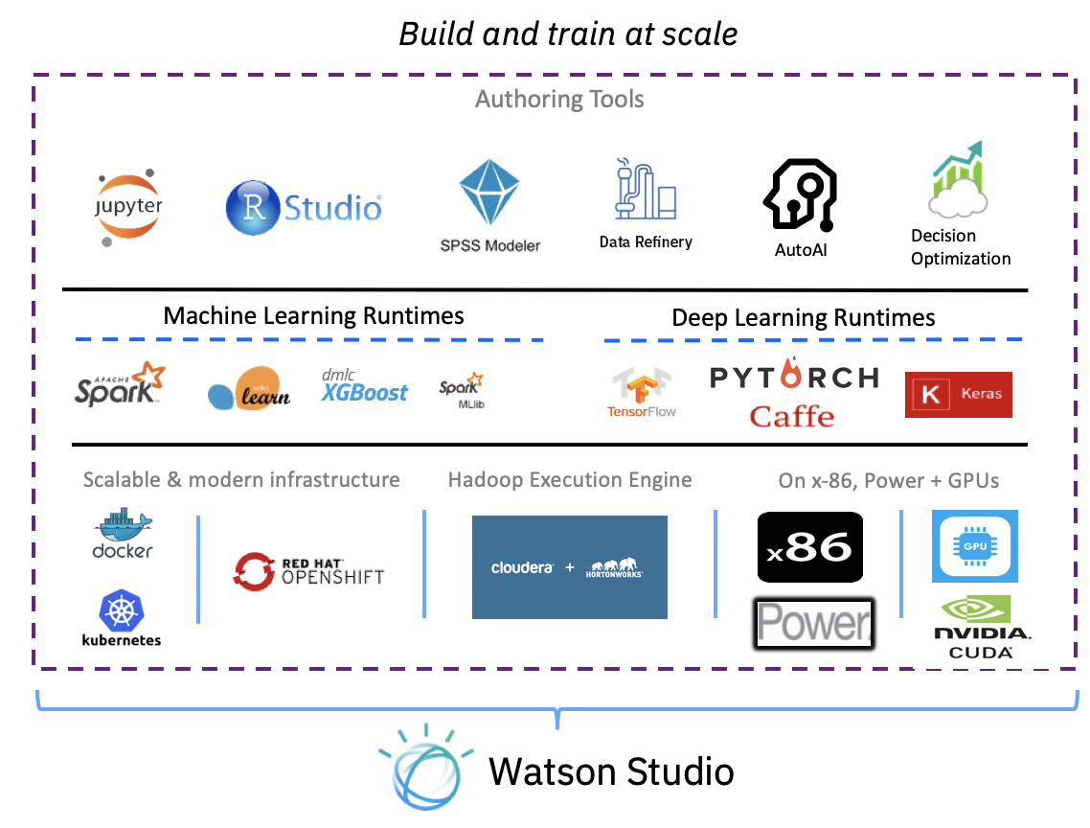
IBM Watson Studio
Enterprise Data Science platform that helps your team work together to build models to make better data driven decisions for your business
Analyze any data, no matter where it lives
Connect to and analyze your data without moving a single byte through dozens of connectors and multiple deployment options
Empower your entire organization with notebooks, visual productivity, and automation tools
Leverage your entire organization with a variety of tools in a single integrated platform
One platform to rule them all from discovery to production
Analyze data, build predictive models, and seamlessly integrate Watson Machine Learning to deploy at scale
Notes:
2. Empower your entire organization with open source integrated development environments (RStudio, Jupyter Notebooks), visual productivity, and automation tools
Without having to move to a new database we have DS solution that will work for you – coud, local dektop, connectors
“we are not making money on where your data is hosted” – you don’t have to move your data
These are things I’m running into
Building upon previous slides what are we introducing today? Meets your wants while solving your problems
Low to high DS skills spectrum
How does WS fit into the trends – looking at BMC for cloud + WS → whatis our value to customer; how are we differentiating from SPSS Modeler?
30 min filling in BMC
30 mins which messages do we want to articulate given strwngths as offering and where we’re going
Goal: crisp & differrentiating
Okay so now diving a level deeper – and again each of these will go back to the 3 values we have on the board
WS = DS platform where your whole team can work together – meaning DS, LOB expert, business analyst, or anyone working on the DS platform – it’s very easy to bring all these people with different levels of expertise on the 1 platform of WS
The reason all these varying levels of expertise can work together is because of these tools you see on the right
DS are rare resources – they each have their own preferences of tools or languages that they want to work with so we have open source tools like R studio and Jupyter Notebooks where DS can come in and write their own code by choosing their own language (R, Scala, whatever they want), and go ahead and get started
At the same time, if someone is not really into coding but has the knowledge, they can use visual tools - like SPSS Modeler, Data Refinery, & Model Builder – where they have a drag and drop UI they can use to build a model normally and get predictions
Both sides are available in the same platform of Watson Studio.
You can give different access to different people.
The whole point is that WS really reduces the barrier between your resources and the DS journey – anyone can get started regardless of their expertise
→ which brings us back to the strategy of increasing your team productivity
You can see on the right, we provide different technologies and frameworks to support building models - you can use Spark or if you're working with Deep Learning we support all the other favorites so you can choose any of these and work on Studio
Let's say you're into deep learning, but you are not a coder, we have a drag & drop interface where you can build a deep learning model, expose that node, and use it in some other applications
We provide all these cutting edge infrastructure technologies so you can take advantage of any of them while you are working in WS
Again: easy, fast, and increases your team productivity
Again getting started very quickly to increase productivity

Slide 16
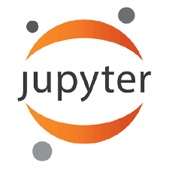
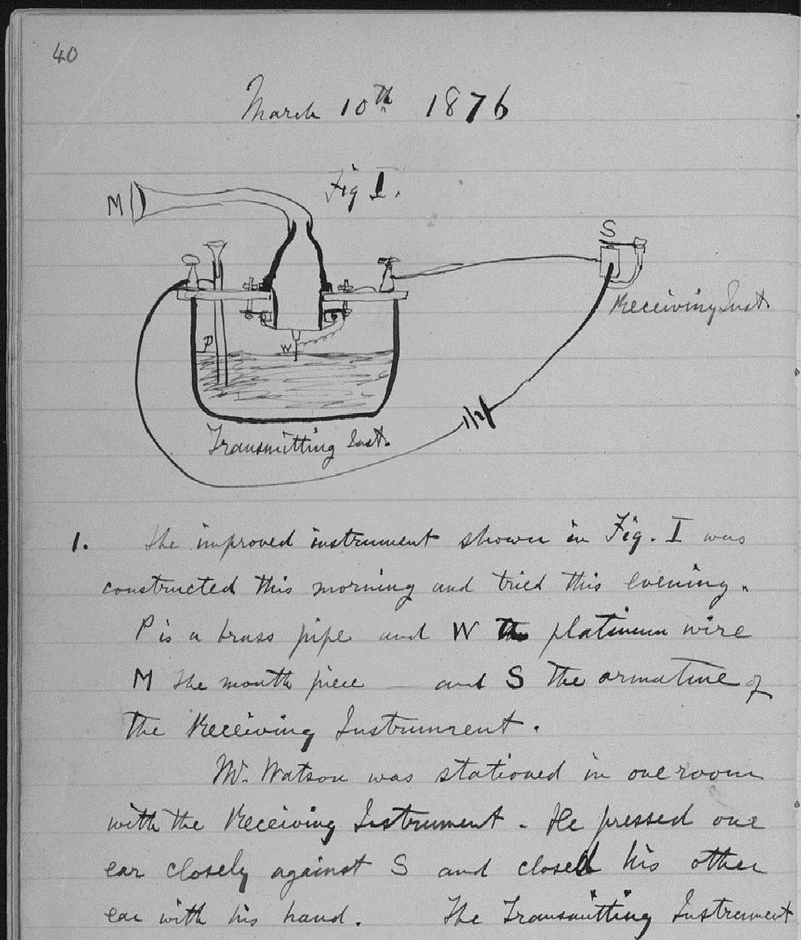
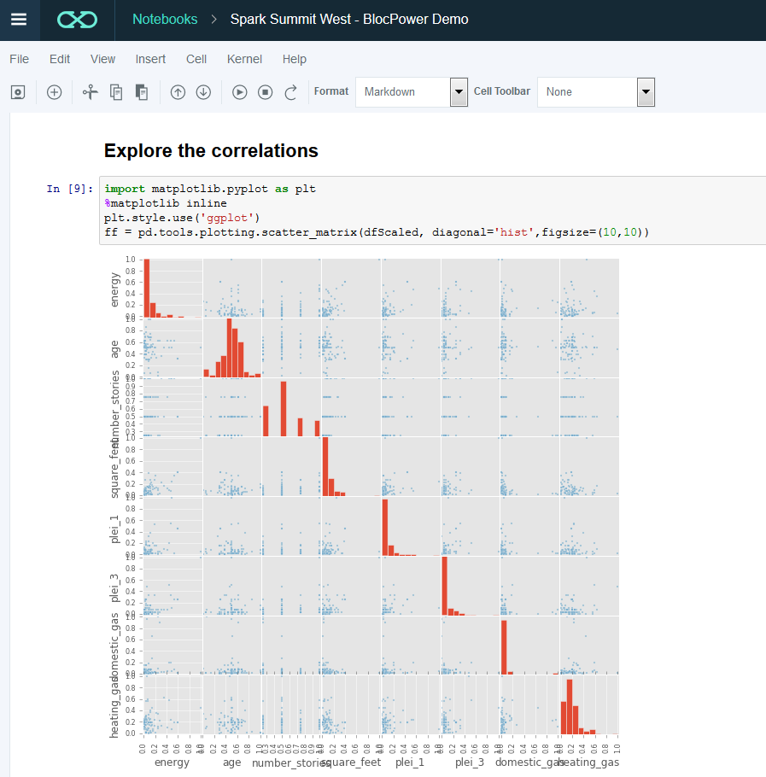
What is a Notebook?
Pen and Paper
Electronic Notebooks
Pen and paper has long provided the rich experience that scientists need to document progress through notes and drawings:
Expressive
Cumulative
Collaborative
Notebooks are the digital equivalent of the “pen and paper” lab notebook, enabling data scientists to document reproducible analysis:
Markdown and visualization
Iterative exploration
Easy to share

Slide 17
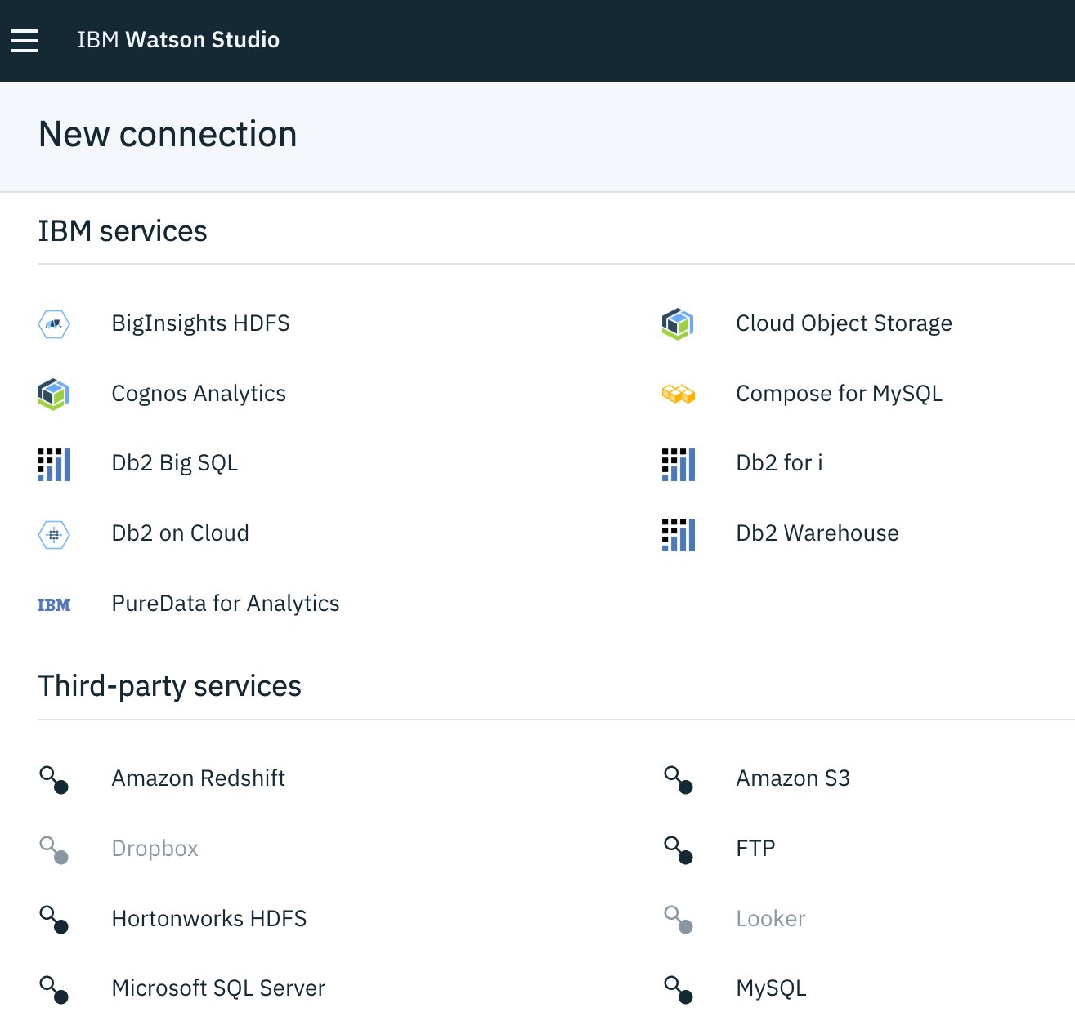
IBM Watson Studio
Enterprise Data Science platform that helps your team work together to build models to make better data driven decisions for your business
Analyze any data, no matter where it lives
Connect to and analyze your data without moving a single byte through dozens of connectors and multiple deployment options
Empower your entire organization with notebooks, visual productivity, and automation tools
Leverage your entire organization with a variety of tools in a single integrated platform
One platform to rule them all from discovery to production
Analyze data, build predictive models, and seamlessly integrate Watson Machine Learning to deploy at scale
IBM Services like Cognos & DB2
3rd Party Services like Amazon S3, Hadoop, & Microsoft SQL Server
We have Public Cloud, Private Cloud, & Desktop/Server deployment options
Notes:
Customers would have excel doc with column with random name + S3 bucket + git issue that is private – things were really all over the place in terms of storage – was even harder for ppl to collaborate let alone take info and consistently &quickly use it to jumpstart projects. We solve these pain points but projects. Connectors play nicely with all kids of different tools, no longer true that you have to go to this person who controls spark cluster to get certain info every time you want to process some data. These people can work together in project to set up repeatable process to be productive with. Richer and easier to use experience.
Saves people time and makes them more productive, When working in notebook, have tools like “insert to code” so if you don’t remember how to connect to Cloudant, no problem, we do that for you. If SPSS modeler user but don’t know how to set up container talking to Hadoop distribution – not a problem, we figure that out → up front development work to figure out stuff no one wants to spend time on
You built models, you can use them by putting things on a presentation
You want to deploy them; challenges of ENGINEERING mis-skill, multi-cloud
Compute intensive. DL distribution, performance in-app or interactive work

Slide 18
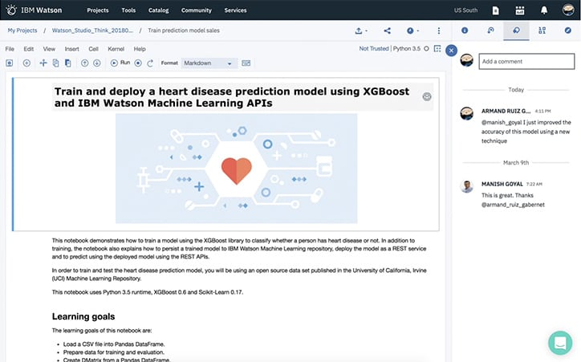
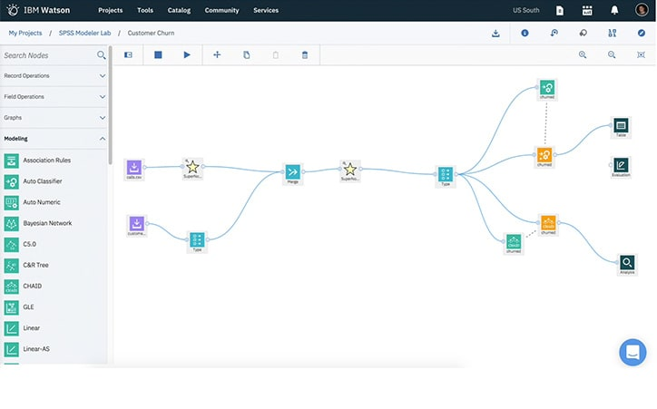
IBM Watson Studio
Enterprise Data Science platform that helps your team work together to build models to make better data driven decisions for your business
Analyze any data, no matter where it lives
Connect to and analyze your data without moving a single byte through dozens of connectors and multiple deployment options
Empower your entire organization with notebooks, visual productivity, and automation tools
Leverage your entire organization with a variety of tools in a single integrated platform
One platform to rule them all from discovery to production
Analyze data, build predictive models, and seamlessly integrate Watson Machine Learning to deploy at scale
Super charged Jupyter Notebooks & R Studio as most popular IDEs for data scientists well integrated with data connectors and rich set of default environments
Visual tools such as SPSS Modeler, Data Refinery, & AutoAI for non coders to analyze data and build models
Notes:
Empower your entire organization with open source integrated development environments (RStudio, Jupyter Notebooks), visual productivity, and automation tools
Technologies like Jupyter Labs, and notebooks, IDEs like R studio – these are some of most powerful and pop open source tools DS and analysts use to get the job done. In isolation these tools don’t have everything you need. You would have to stitch together a lot of open source solutions. Move data into development environment, productionizing work that comes out of that – these things matter when you're not just doing ad hoc analysis with no time pressure. We think about those things and we build for those kinds of users.
We have curated images where we expand upon default coming from Anaconda. We put extra IBM tech in there like DO (which you can only get in our notebook environment) + new spatial temporal packages. We also worked on Jupyter Kernel Gateway (how to get notebooks to talk to Spark clusters) which we ended up open sourcing. We are integrating this tech in WS.
You built models, you can use them by putting things on a presentation
You want to deploy them; challenges of ENGINEERING mis-skill, multi-cloud
Compute intensive. DL distribution, performance in-app or interactive work

Slide 19



IBM Watson Studio
Enterprise Data Science platform that helps your team work together to build models to make better data driven decisions for your business
Analyze any data, no matter where it lives
Connect to and analyze your data without moving a single byte through dozens of connectors and multiple deployment options
Empower your entire organization with notebooks, visual productivity, and automation tools
Leverage your entire organization with a variety of tools in a single integrated platform
One platform to rule them all from discovery to production
Analyze data, build predictive models, and seamlessly integrate Watson Machine Learning to deploy at scale
Seamless integration with:
Watson Knowledge Catalog brings governance & catalog management
Watson Machine Learning deploys, manages, & automatically retrains your models
Watson OpenScale offers unmatched levels of trust in automation

Slide 20
Watson Studio
Data Refinery

Slide 21
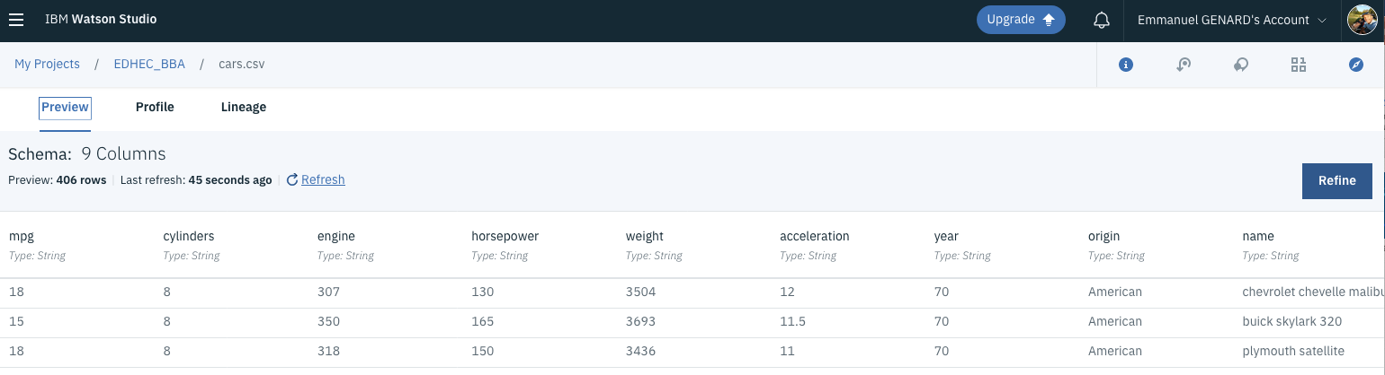
Data Refinery
Allows low-code implementation of Data Processing pipelines
Data processing steps are composed through a simple GUI
Uses dplyr as the underlying language
Creates a ‘Data Flow’, which can run against same-shape data sources
Can read and write several formats, DB connection, CSV, Parquet, Avro...

Slide 22
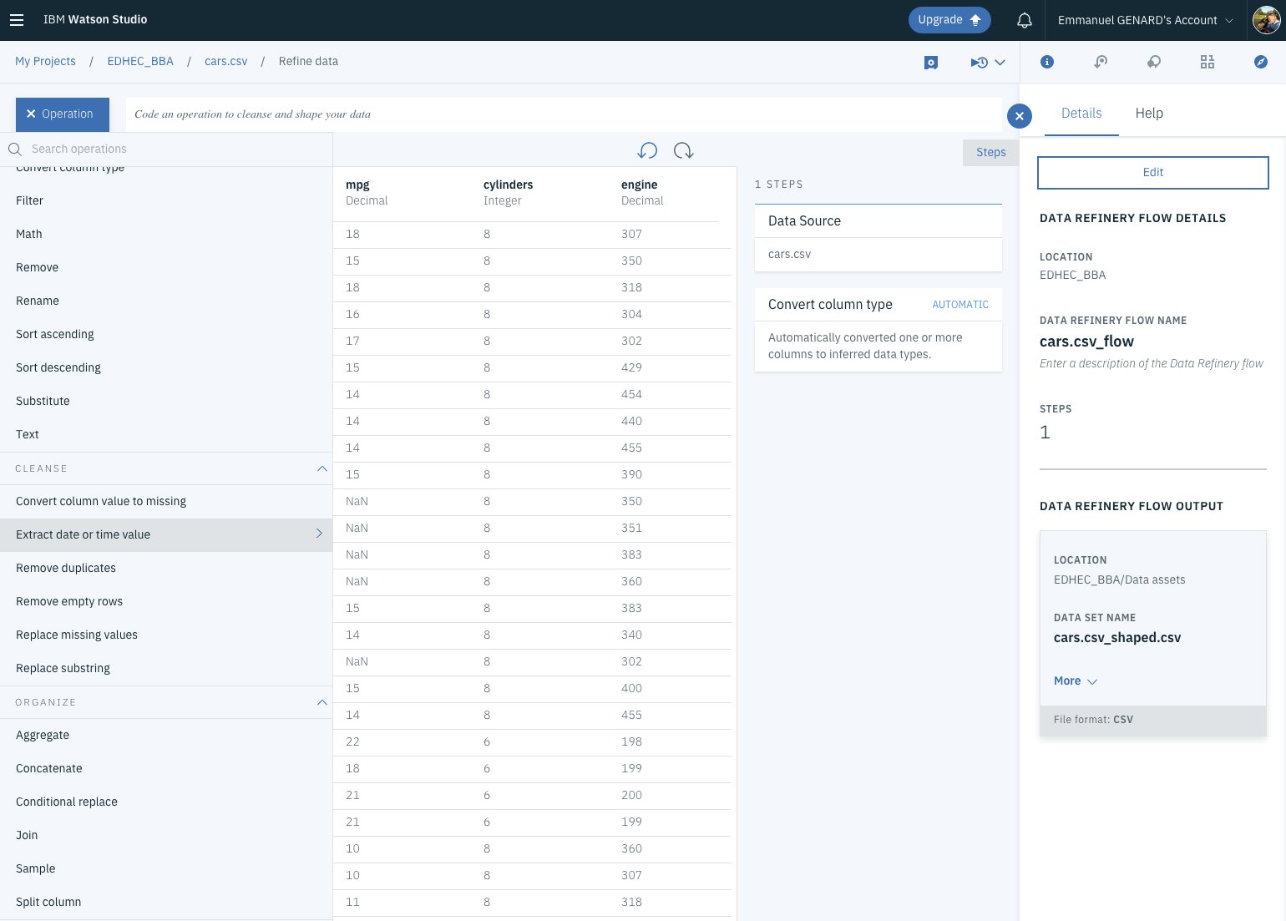
Data Refinery

Slide 23
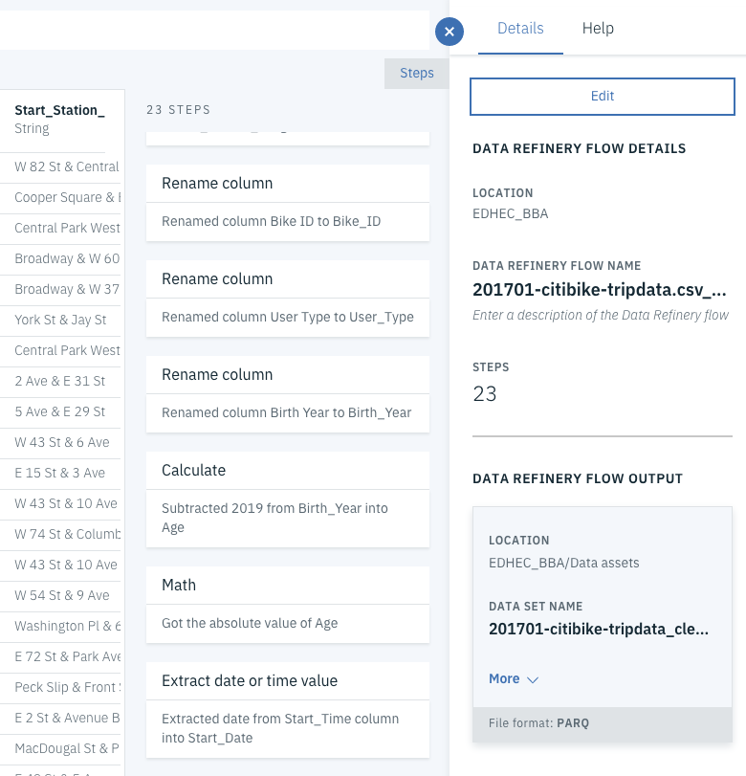
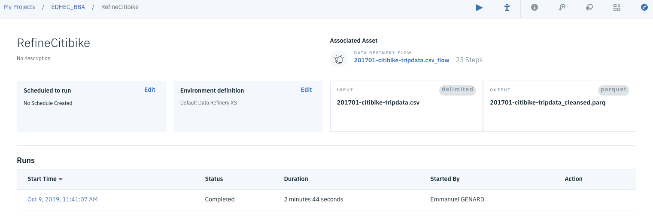
Data Refinery
Data Flows can be deployed as Jobs
Jobs are running in a managed runtime
dplyr code is translated to Spark for optimized execution
Job execution triggers:
Manual or through API
Scheduled to run at a given time or periodically
Data Flows are used to implement recurring data engineering tasks
Data Extraction, Filtering and Transformation

Slide 24
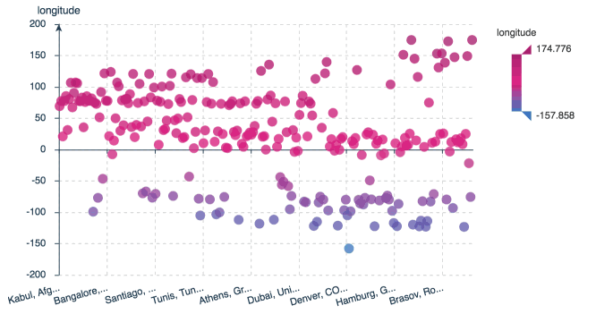
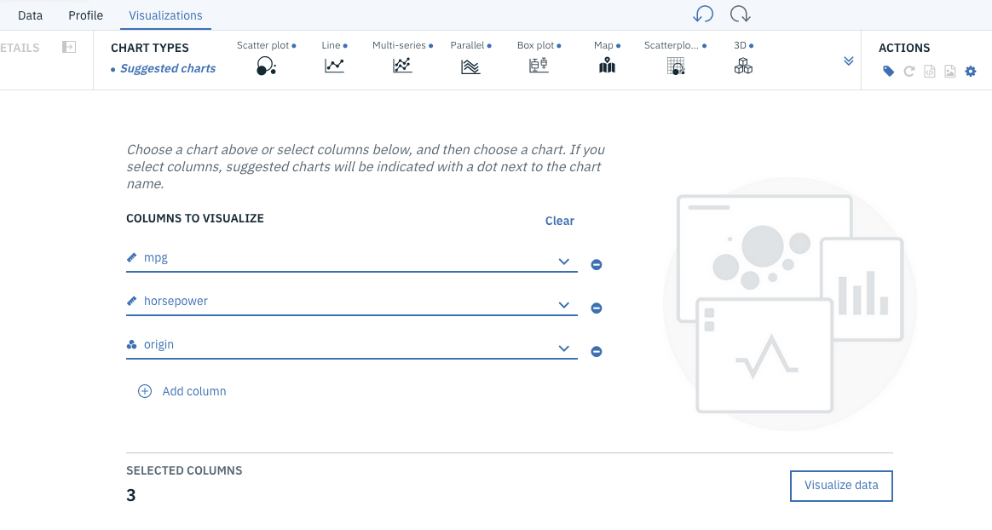
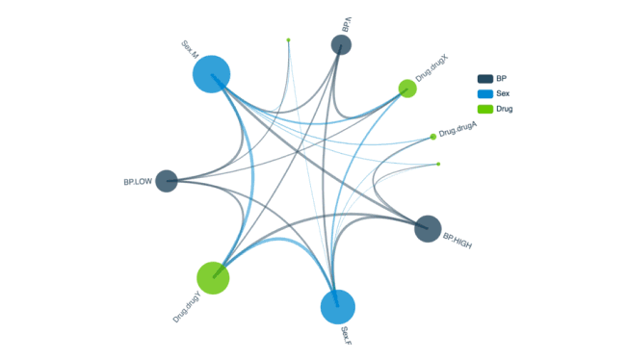
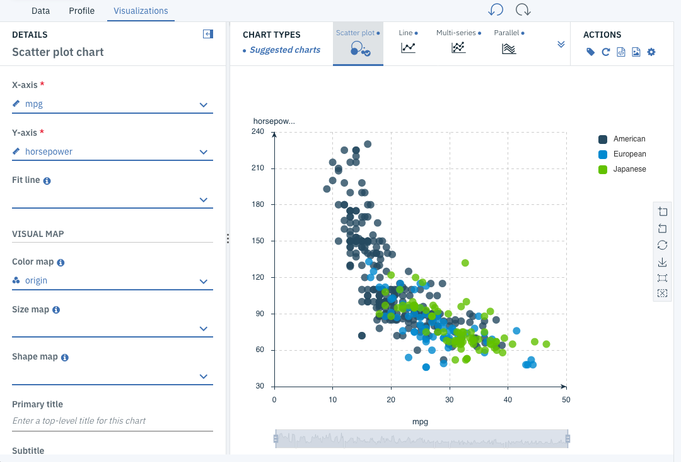
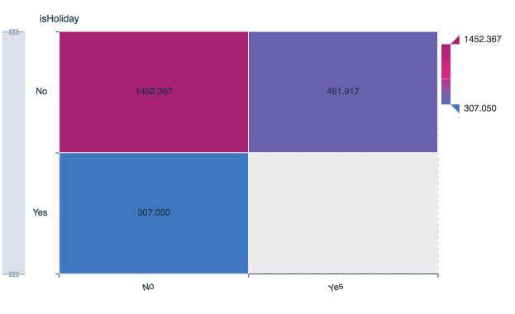
Visualize your data in Data Refinery
Data Refinery provides support for the following charts:
3D charts, Bar charts, Box plot, Candlestick, Dual Y-axes, Error bars, Heat maps, Histogram charts, Line charts, Map charts, Multi-series charts, Parallel coordinate charts, Pie charts, Population Pyramid charts, Quantile-quantile plot charts, Relationship charts, Scatterplots, Word Cloud…
Notes:
Data Refinery provides support for the following charts:
3D charts display data in a 3-D coordinate system by drawing each column as a cuboid to create a 3D effect.
Bar charts are handy for displaying and comparing categories of data side-by-side. The bars can be in any order. You can also arrange them from high to low or from low to high.
Box plot charts compare distributions between many groups or data sets. They display the variation in groups of data: the spread and skew of that data as well as outliers.
Candlestick charts are a type of financial chart that displays price movements of a security, derivative, or currency.
Customized charts give you the ability to render charts based on JSON input.
Dual Y-axes charts use two Y-axis variables to show relationships between data.
Error bars indicate the error or uncertainty in a value, and they give a general idea of how precise a value is or conversely, how far a value might be from the true value.
Heat map charts display data as color to convey activity levels or density. Typically low values are displayed as cooler colors and high values are displayed as warmer colors.
Histogram charts show the frequency distribution of data.
Line charts show trends in data over time by calculating a summary statistic for one column for each value of another column and then drawing a line connecting the values.
Map charts show geographic point data, enabling you to compare values and show categories across geographical regions.
Multi-series charts display data from multiple data sets or multiple columns as a series of points connected by straight lines or bars.
Parallel coordinate charts display and compare rows of data (called profiles) to find similarities. Each row is a line and the value in each column of the row is represented by a point on that line.
Pie charts show proportion. Each value in a series is displayed as a proportional slice of the pie, with the pie representing the total sum of the values.
Population pyramid charts show the frequency distribution of a variable across categories. They are typically used to show changes in demographic data.
Quantile-quantile (Q-Q) plot charts compare the expected distribution values with the observed values by plotting their quantiles.
Relationship charts show how columns of data relate to one another and what the strength of that relationship is by using varying types of lines.
Scatter plot charts show correlation (how much one variable is affected by another) by displaying and comparing the values in two columns.
Scatterplot matrix charts are scatter plot charts organized into a matrix so that it is easy to look at all pairwise correlations together.
t-SNE charts help you visualize high-dimensional data sets. They’re useful for embedding high-dimensional data into a space of two or three dimensions, which can then be visualized in a scatter plot.
Treemap charts display hierarchical data as a set of nested areas. Use to compare sizes between groups and single elements nested in the groups.
Word cloud charts display how frequently words appear in text by making the size of each word proportional to its frequency.

Slide 25
Watson Studio
Data Visualization

Slide 26
Data Visualization with Watson Studio
Introduction to Data Visualization in notebooks.
Standard notebook visualisation: Mathplotlib quick review, R & Shinny
IBM visualization packages: Brunel and PixieDust overview
Publishing visualizations and graphs
Hans-on-Labs: Getting started with Brunel & Pixie Dust
A three-part lab
Charting Pandas with Brunel
Exploring DataFrames with PixieDust
Building dashboards with Cognos Dashboard Embedded service

Slide 27
Descriptive Analytics introduction
Descriptive Analytics is usually the first step towards understanding your data shaping and structure
Main way to conduct descriptive analytics is to build visualizations
For data exploration, performed by the data scientist as an iterative quest, using notebook visualization libraries
For reporting, through dashboards that are built for business stakeholders and external consumption
Usually, dashboarding is the final stage, as it requires a proper understanding of the data and some feature engineering to arrange the data in a suitable way
Aggregations to reduce volume, derived attributes, …

Slide 28
Visualization technologies in notebooks
The major library used in Jupyter notebooks is called matplotlib
Provides a very extensive set of graphical visualizations
https://matplotlib.org/gallery/index.html
It is a library, which requires Python code to create visualizations
Very well supported by Pandas dataframes (df.plot())
Spark dataframes need to be converted to pandas
Other libraries exist, such as seaborn, bokeh (interactive), plot.ly, …
R Studio has its own library called Shiny
Also a very extensive scope of graphical visualizations
https://shiny.rstudio.com/gallery/
Provides the ability to publish interactive graphical output as ‘Shiny Apps’

Slide 29

IBM contribution to Notebook visualization
IBM has a long-standing background in data visualization technologies
Promoter of the RAVE client-side visualization framework
The goal is to provide higher-level non-programmatic visualization capabilities
IBM has worked on two libraries made available as Open-source:
Brunel: https://github.com/Brunel-Visualization/Brunel
Brunel defines a highly succinct and novel language that defines interactive data visualizations based on tabular data.
Zero to Visualization in Sixty Seconds
Supports Jupyter, R and Spark
PixieDust: https://github.com/ibm-watson-data-lab/pixiedust
Designed for interactive data visualization to support data exploration
Supports Jupyter and Spark (Scala)

Slide 30
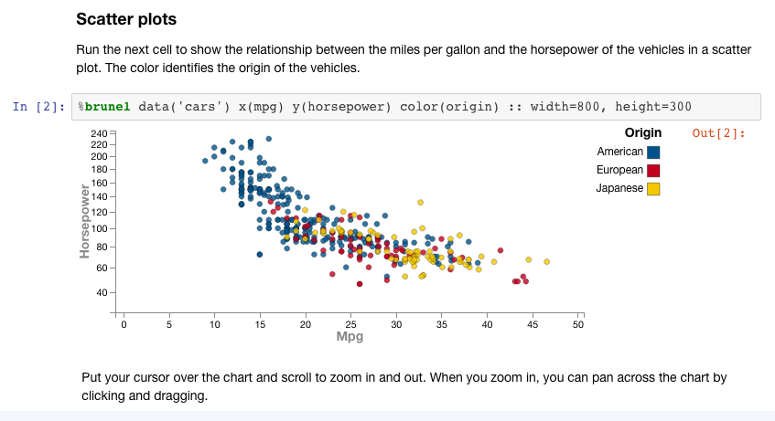
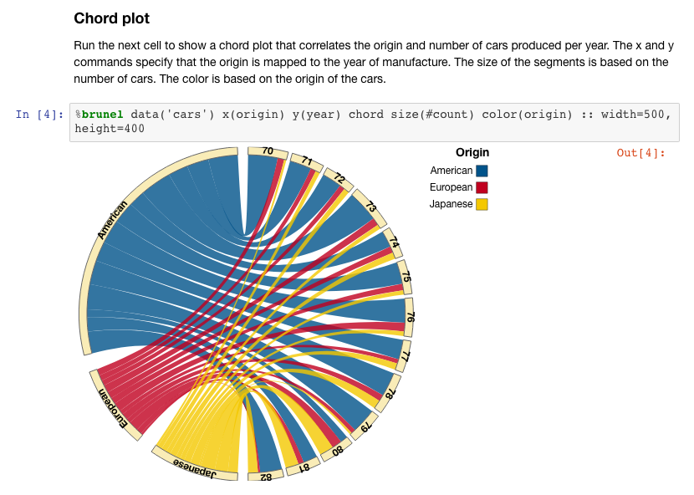
Brunel visualizations
Brunel is a high-level visualization library
Open-sourced in Github
https://github.com/Brunel-Visualization/Brunel
Extensive types of graphs, including maps, tagclouds, chords,
https://github.com/Brunel-Visualization/Brunel/wiki#samples
Language-agnostic, with Jupyter/Python bindings
Operates on Pandas DataFrames
One-line description of the visualization is sufficient to produce complete graphics
Brunel vizualizations can be zoomed and scrolled but are not actionable

Slide 31

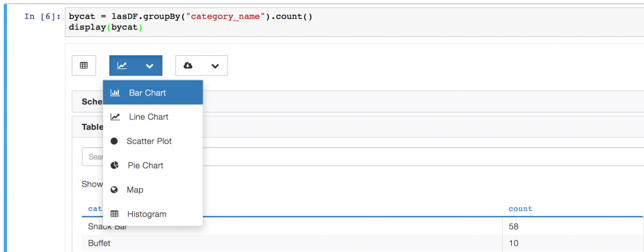
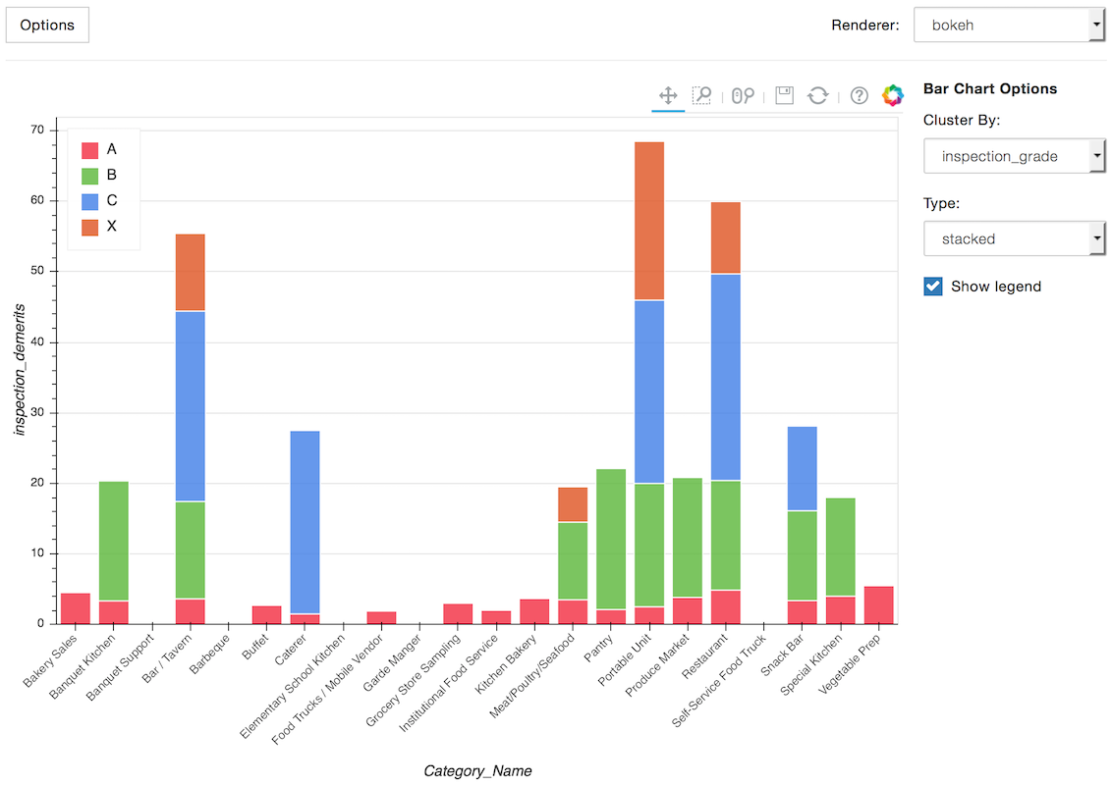
PixieDust
PixieDust is a visual data exploration framework for Jupyter and Spark
An IBM-contributed open-source project
https://github.com/ibm-watson-data-lab/pixiedust
Goal is to provide visual insights that are extremely interactive
User can dynamically change graph types and contents
Many types of graphs, including tabular, maps, …
PixieDust operates on Pandas or Spark DataFrames
Minimal API: display(df)
PixieApps
Similarly to R’s Shiny, live dashboards can be published as Web Apps
https://ibm-watson-data-lab.github.io/pixiedust/pixieapps.html

Slide 32
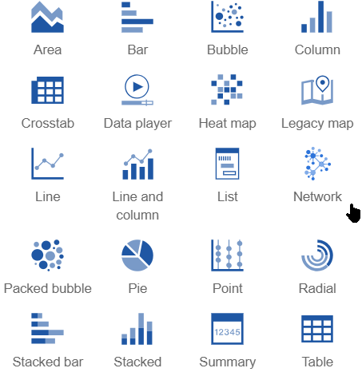
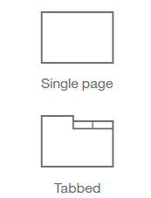
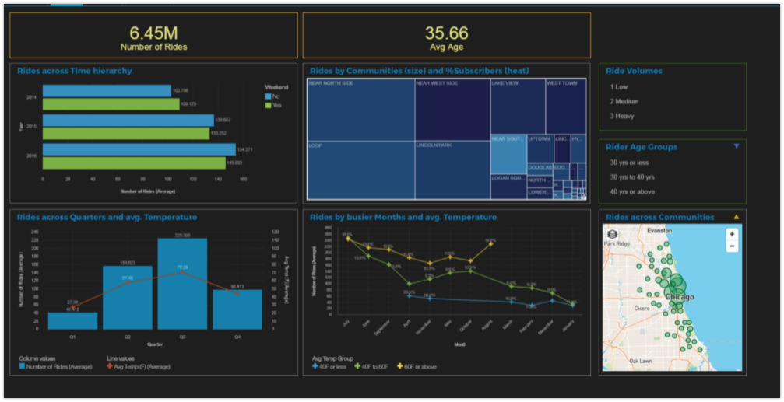
Watson Studio Analytics Dashboards
Interactive UI-driven dashboard builder
Tooling part of Watson Studio
Leverages Watson Studio Data Sources
Advanced dashboarding capabilities
Multi-tab layouts with linked graphical widgets
Many visualization types
Application integration
Dashboard can be published for external viewing
Dashboards can be integrated in an outside web application
Using the client-side JavaScript CognosAPI

Slide 33
Notes:
5 min-10 min demo depending on what customers prefer. Look at potential list here
Demo suite
https://ibm.box.com/s/zckvjgofds7q8vpq08w8qchci83jppe3

Slide 34
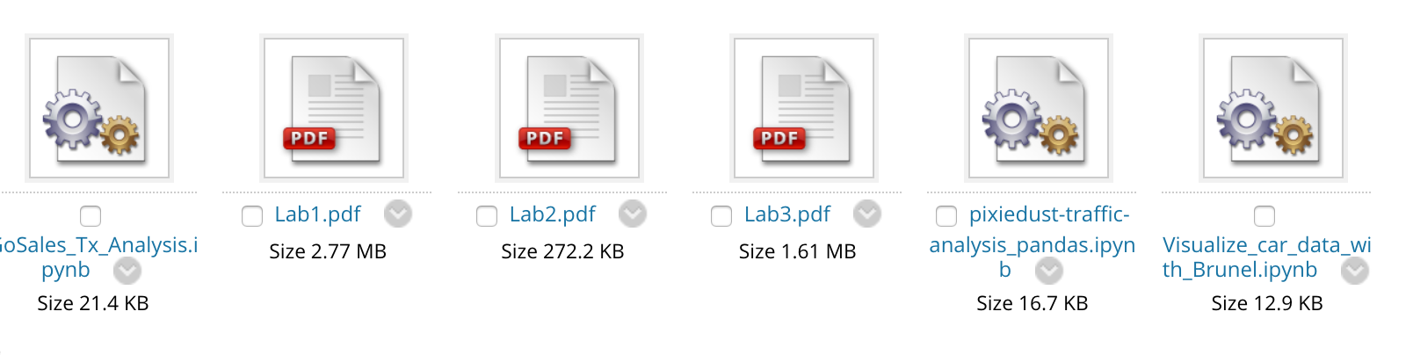
Time for Lab 2: Data Refinery and Visualizations
This lab is multipart
Data Preparation using Watson Studio Data Refinery
Data Visualization Experiment with Brunel visualizations
Experiment with PixieDust interactive visualization
Build a Dashboard using Watson Studio’s Cognos Dashboard service
Lab material at https://github.com/Azzoz06/EDHEC_BBA_19_20 or on Blackboard
Folder TP_Consumers_Insights_and_Big_data\Day2

Slide 35

20
Thank You!

